Slide 1
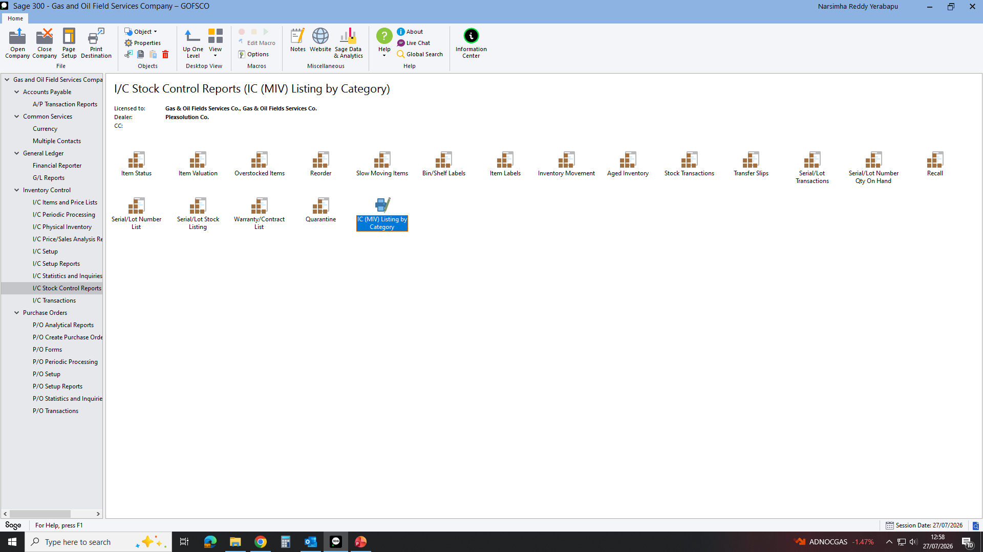
TO GET MIV REPORT GO TO INVENTORY COLTROL: I/C STOCK CONTROL REPORTS THEN IC (MIV) LISTING BY CATERORY THEN GO AS BELOW

Slide 2
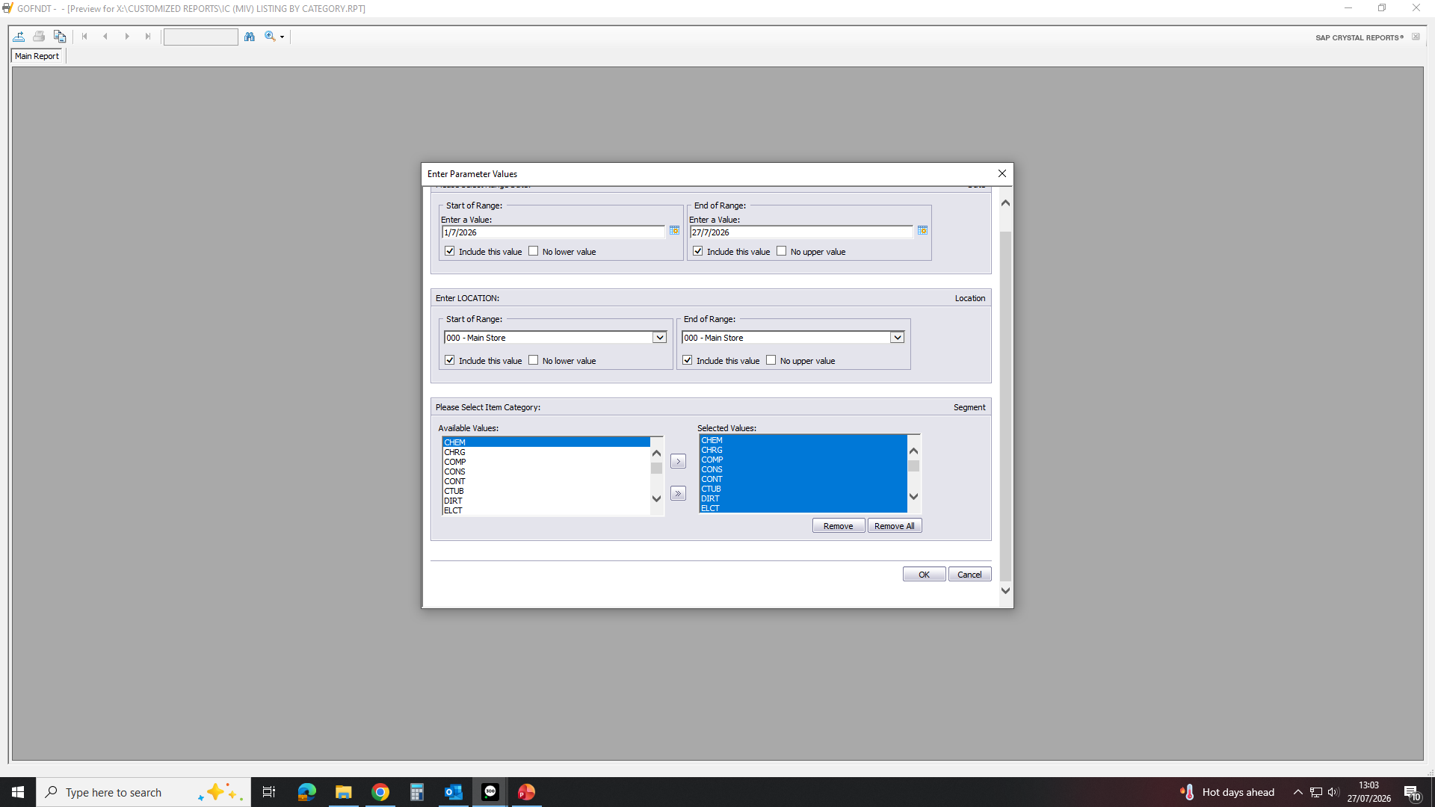
FILL AS NEEDED REPORT THEN CLICK OK. WILL GET EXCELL SHEET. AND ORGANISE.

